Slide 1

Start at the Beginning
Your Logo Here
Automating Network Design (and other beginnings)
Claudia de Luna

Slide 2
The Networking Bottleneck
In the beginning…
Networking has been a bottleneck to service delivery
Networking has been slow to embrace automation
Is there a relationship? If Yes, why?
Consider Centralized control vs Decentralized (box by box)
Notes:
Networking has been a bottleneck to service delivery
Networking has been slow to embrace automation
Debate degrees
Would we be here if...
If there was unlimited funding and an available workforce so that the networking service delivered as fast or significantly faster 24x7 would that work?
Cloud teams showed what could be done with automation so really what we have been asking is “why cant networking operate like cloud providers” who can sping up a fully formed server on demand and within minutes.

Slide 3
The Challenge
Networking was challenged to address the bottleneck with automation
Was that the right solution for networking?
In the cloud, that may have been obvious
For everyone else, I don’t think anyone ever asked, just assumed that solution would fit
We went right to NetDevOps and missed a few things
Notes:
We called it network automation….but what was it really? Did we think the network engineers were not going to notice it was software development?
Its not medicine…its candy! it’s a cherry flavored gummy!
Is network automation like DNS or like ITIL?
Are we the TDM engineers? Railing against IP Telephony? Yes and No
Network automation is a technique to offer higher quality and speedier networking worflows. It is not a service in and of itself. Its not DNS. Its not even IP Telephony.
There was a fundamental disconnect between cloud and a multivendor mutli team brownfield networks, feature gaps across network estantes

Slide 4
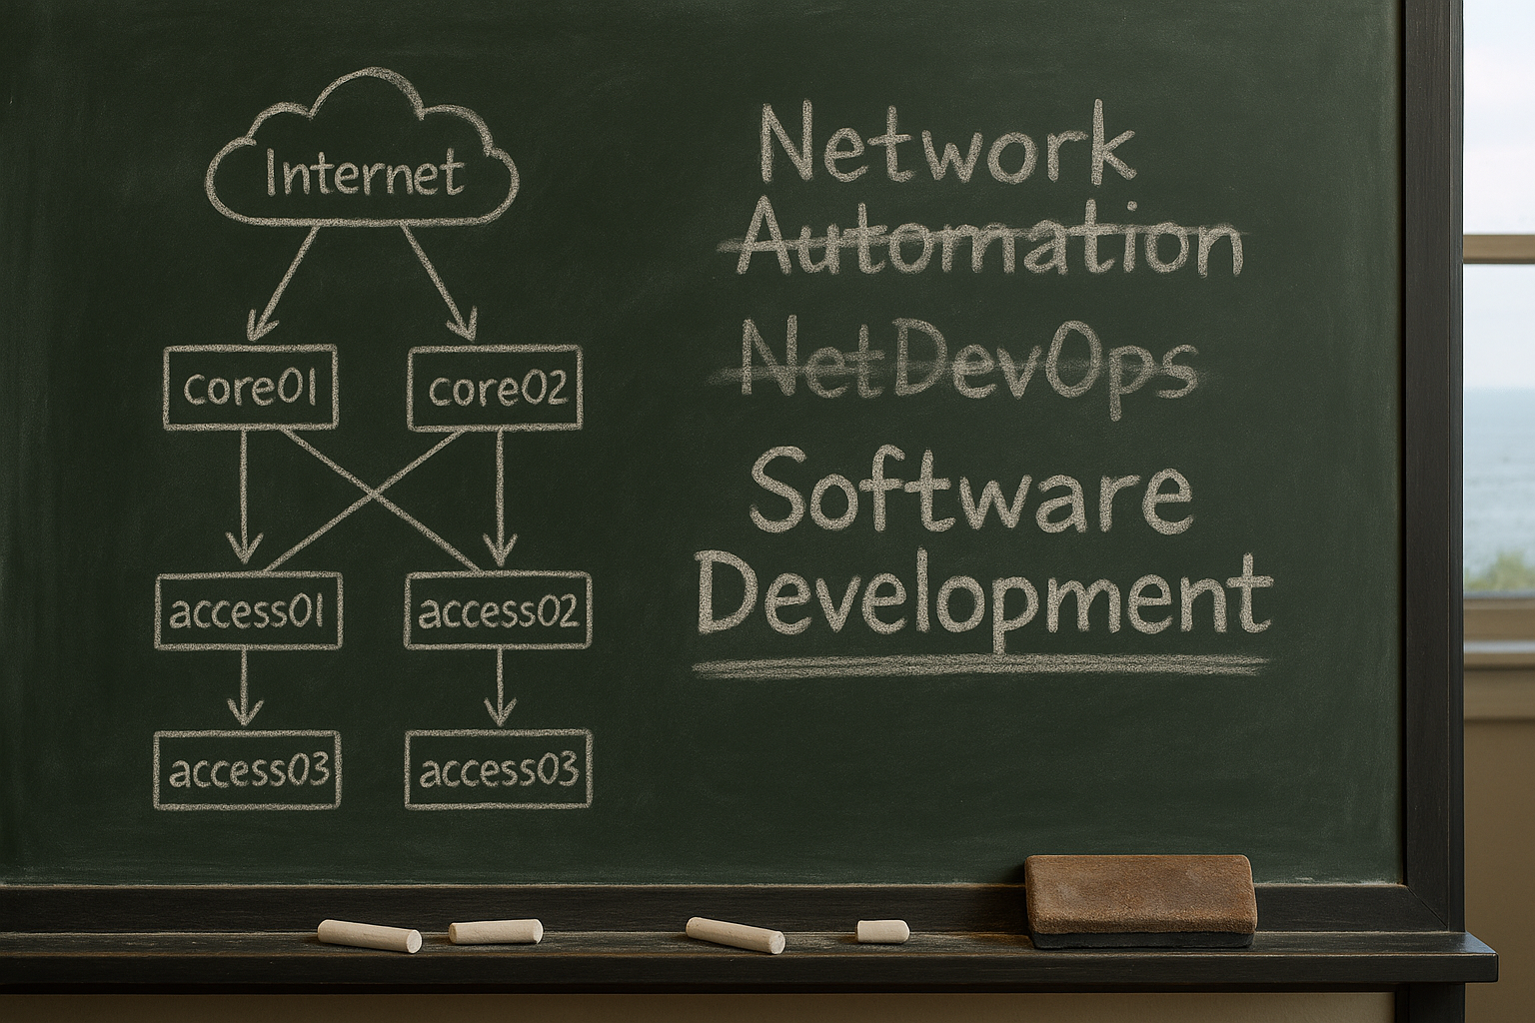
The power of naming
“In retrospect, DevOps was a bad idea” - Adam Ard
https://rethinkingsoftware.substack.com/
Notes:
https://rethinkingsoftware.substack.com/p/in-retrospect-devops-was-a-bad-idea

Slide 5
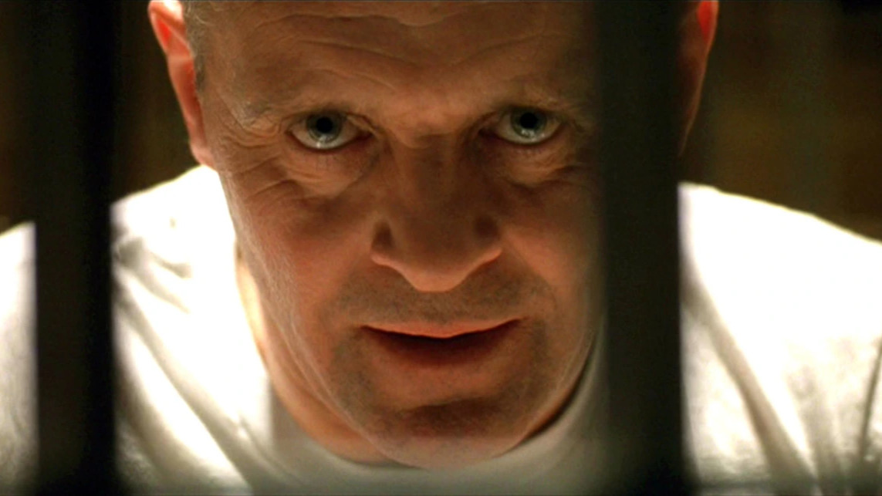
Begin by asking better questions
"What is it in itself? What is its nature? What does [it] do?- Marcus Aurelius
Notes:
https://www.youtube.com/watch?v=hOPhqi8Qlcc

Slide 6

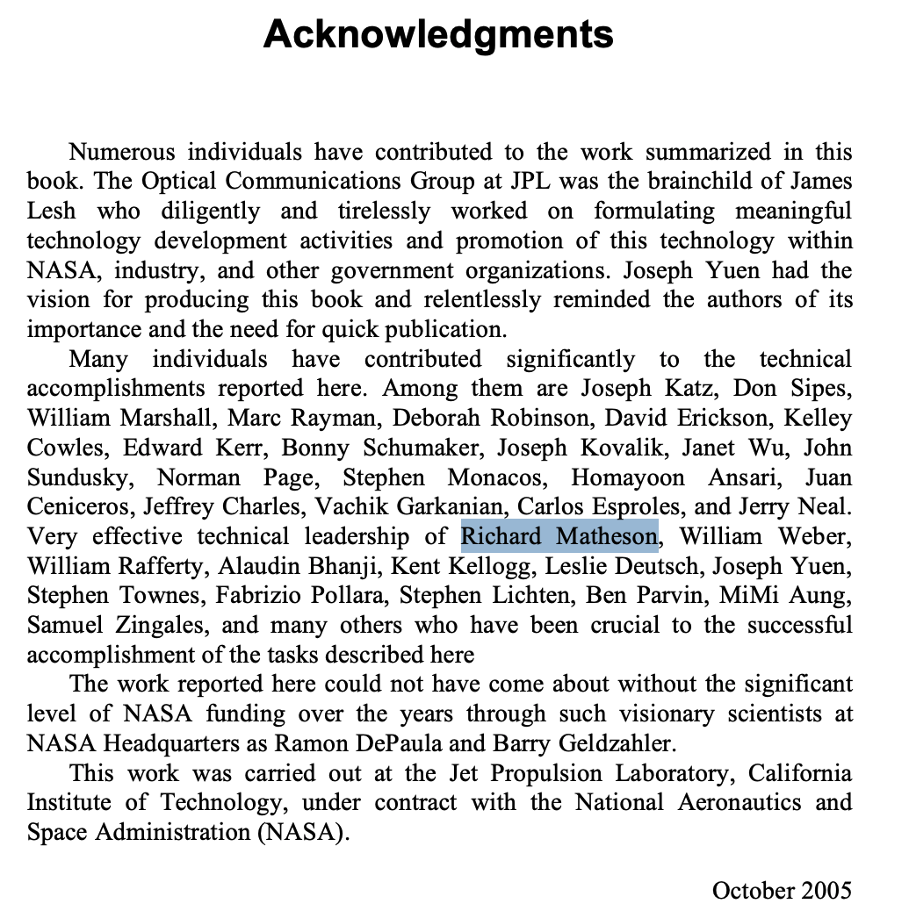
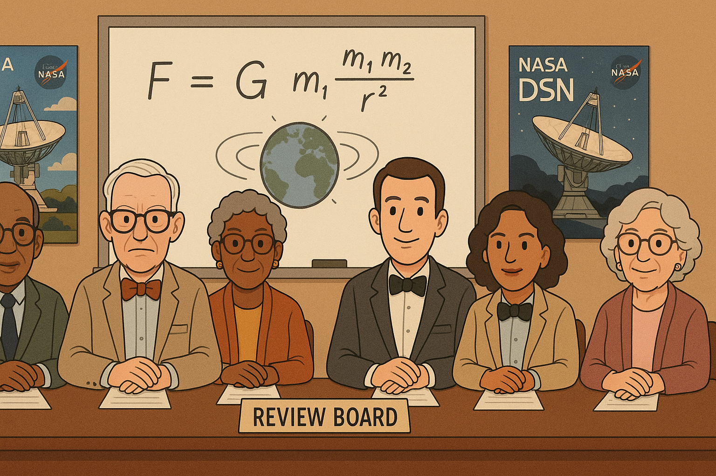
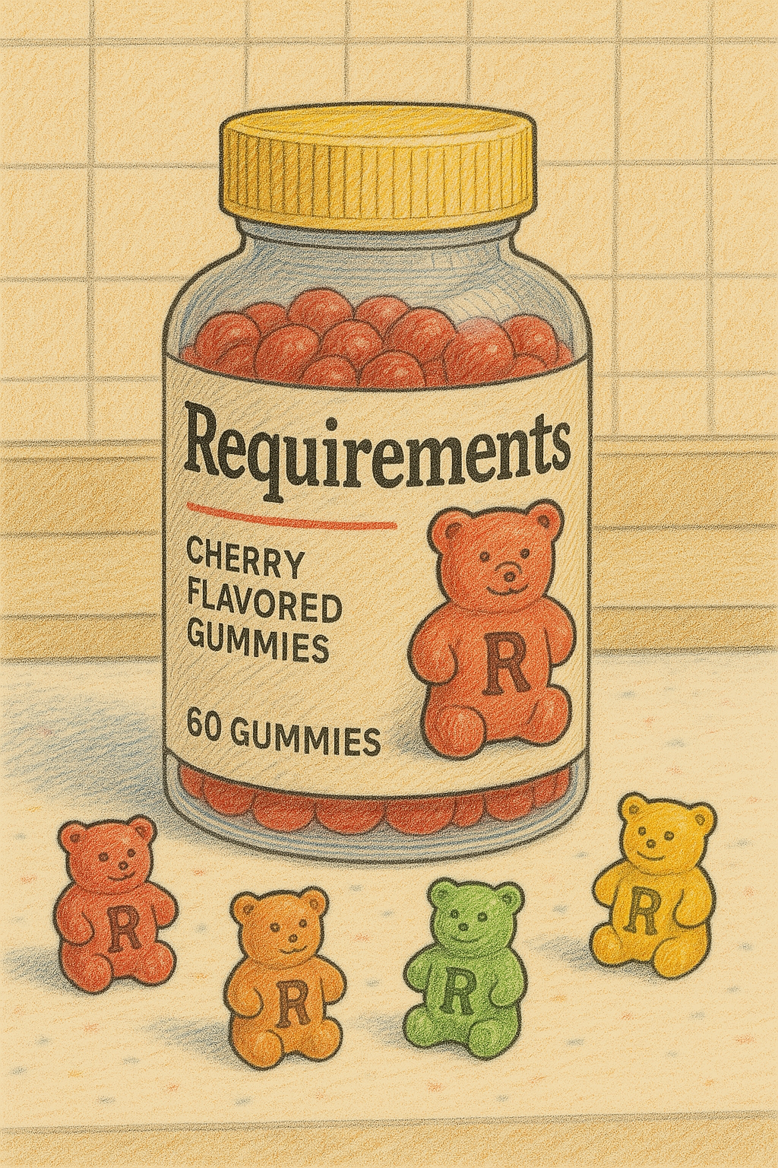
The dirty word
Requirements
Notes:
Just a few years out of university I left the software development team and started with the networking team. One day my boss asks me what I know about structured cabling. I tell him “Nothing” to which he responds. ”You better learn”
A few months later I am standing in front of a review board comprised of many of the senior mission managers at NASAs/JPL. The chair of the board is a gentleman named Dick Matheson. Id say the Lab was collectively terrified of him. He could kill a project with a look. He was famous for his brutal brevity and evisceration skills and his bowties. Professionally that may still be the most terrifying presentation of my life. I go through my requirements matrix and then my design document showing how each component references back to the requirements, talk about the standards we will follow, selection criteria for cabling vendors, how we are going to test and manage the system, all the way down to the labeling standard we will use to identify each cabling run.
I conclude my presentation and now its time for the board to tear me to shreds.
Mr. Matheson asks “Who did this?” at which point Im mentally starting to pack my desk.
Nothing for it, I have to answer..”I did sir, but with quite a bit of help”. Brief nod. ”Who came up with the labeling standard”…I'm pretty sure I was starting to fold into the fetal position at this point. “I did, sir”
”Good job” “well thought out labeling scheme”.
At that point everyone on the review board, packed up their notebooks and left.
I was bewildered. My boss comes over and says..OK…we passed the review board. Lets get started….Thats it? I shriek. He chuckles…that was high praise from Dick Matheson. That was a parade. We got the green light.

Slide 7
…and so, we started without asking many of the right questions and without requirements

Slide 8
Our Current Focus
Operations
Source of truth
Learning Python (programming language)
Tools
Notes:
And so we started with operations
And we struggled with the meaning of “source of truth”
And soon the tool scape was overwhelming
I do think the focus has started to shift, in no small part due to this community

Slide 9
Operations is important
But not at the expense of design
No perspective, no view from the bunker or trench
You are just trying to stay alive
And yet this happens all the time, still
My beginning - The network group when I joined
Notes:
What are you going to operate if no one is thinking about the next…service, technology, feature….?
Software developers have the opposite problem
So this is a marriage made in heaven?

Slide 10
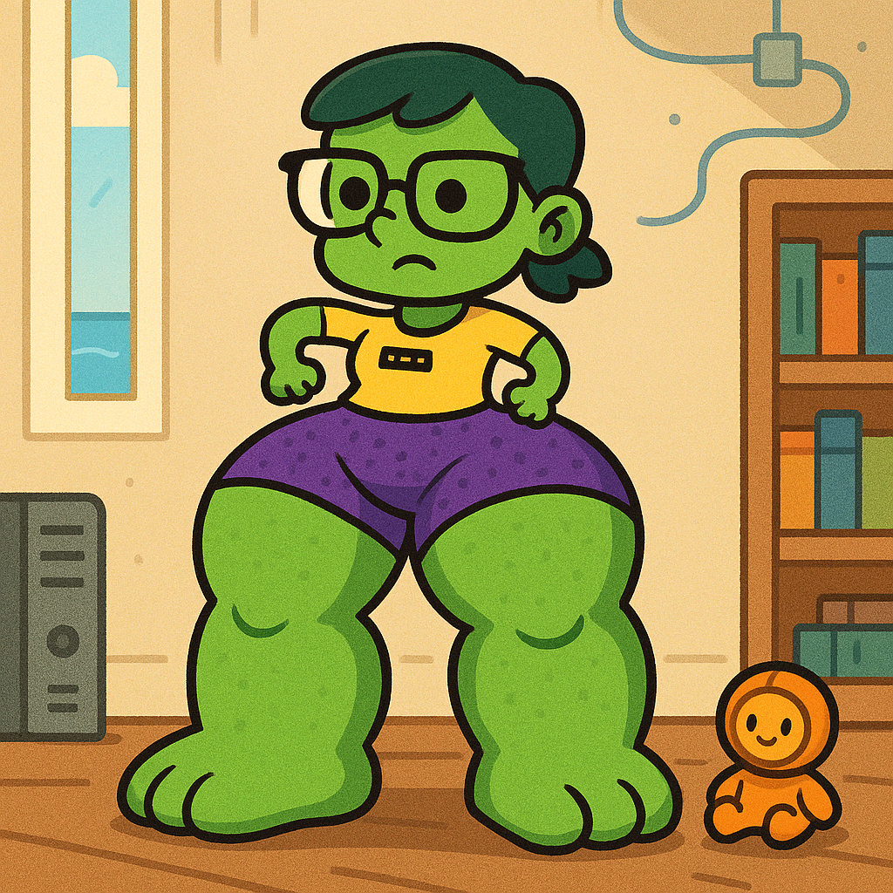
Started in the middle
Disorientation
Ambiguous Goals
Ambiguous Success
Partial Solutions
Bad behavior
Tortured paths
Overdevelopment of some muscles at the expense of others
Some would say this is what happens without requirements…
Notes:
Why is it so hard to define network automation, source of truth, why is it so hard to develop a framework?
There is value in starting in the middle…you learn what not to do and it’s a big payoff

Slide 11

We are here
Limited perspective
Notes:
You are here map without the rest of the contect The rest of the map is missing

Slide 12
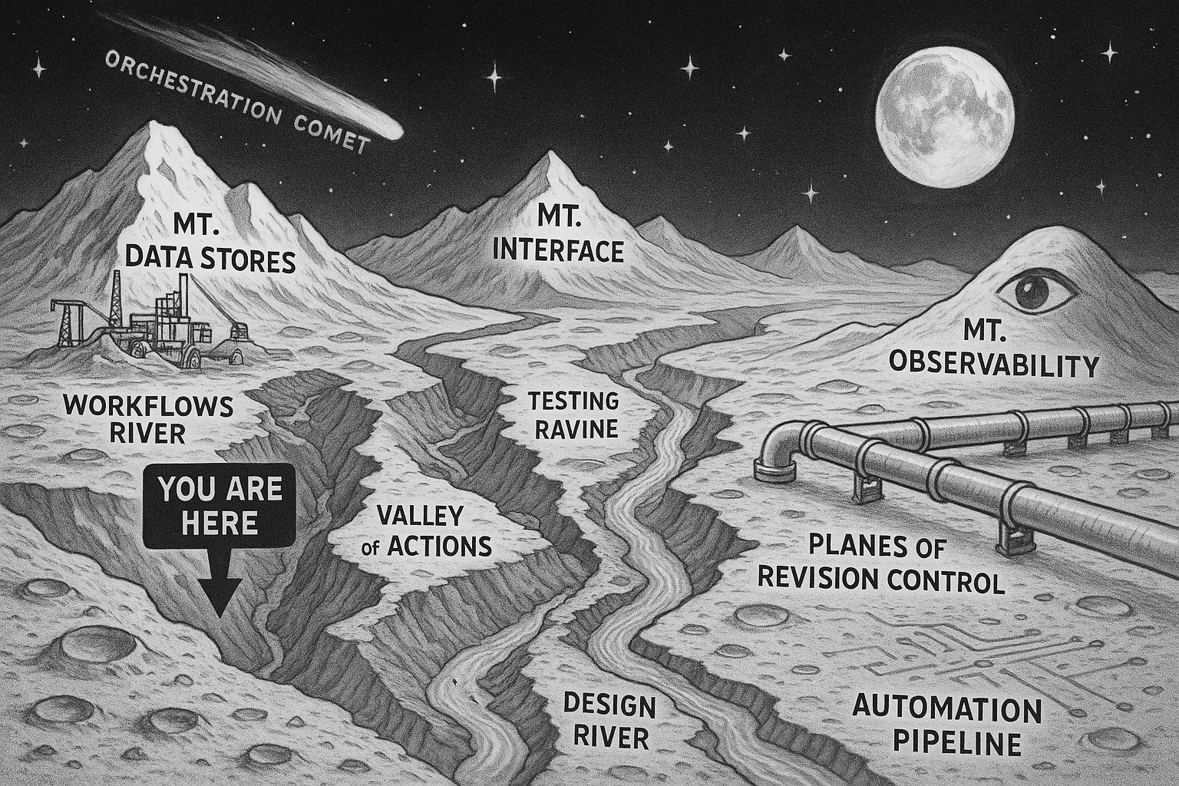
Full landscape is emerging

Slide 13
Begin at the Beginning
The end-to-end process
Is a pipeline that is hard to fill
Tools will not solve the problem
They may solve A problem
Tools are just exercise equipment
You still must do the work
probably why we gloss over it
probably why we can't articulate a framework
Notes:
It is a process
Its been done before
Temporal Example
Alex Garnett
https://www.youtube.com/watch?v=n__rXmGjwYY

Slide 14
What if…
We lived in a world which started with design
Would Truth be Ambiguous?
That world is already here
Excellent examples (Christian Adell Querol, Jeremy Schulman)
The tooling is here (but you can start without it!)
Notes:
Starting is easier than you think
Without any new tools
Its not that we don’t know the trhuth, its that we can’t use it!

Slide 15
The source of truth struggle
If our process began with the details of what we were building, would truth be such a struggle?
We spend too much time asking ”what should it be?”
Looking for the answer outside of doing the work
We know what it should be, we may have it fully documented, we just can’t use it!

Slide 16
Programmatically consumable design
In our new world, the answer to “what should it be?” needs to be programmatically consumable data
The pipeline needs structured data flowing through it

Slide 17
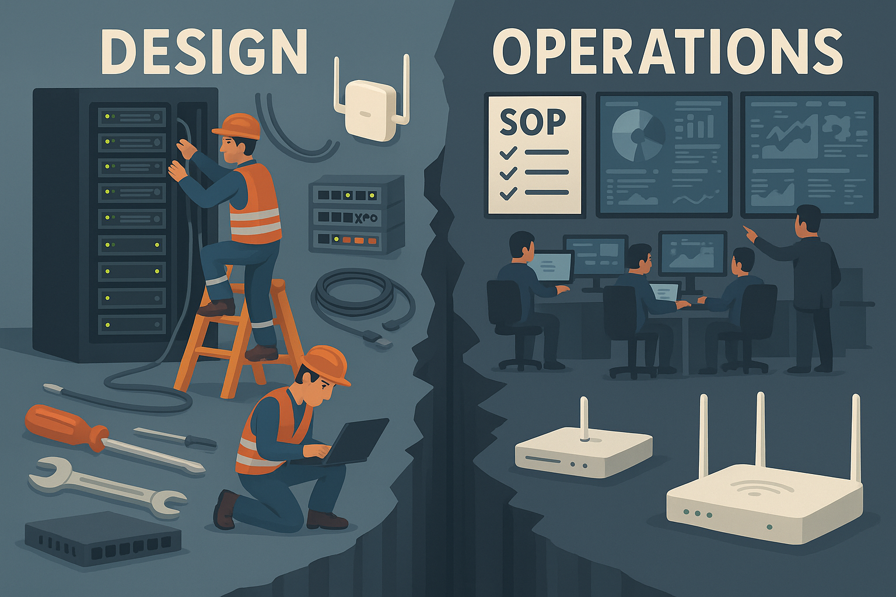
The delivery to operations chasm
I've made several trips here
Notes:
Warning: The delivery to operations chasm
Anecdote - Part 2
Quote from JH
Lets learn from history
Embrace the DRY

Slide 18
Begin by asking the right questions
What problem are we trying to solve?
How will this product or service help solve the problem?
Who is going to implement the solution?
How are we going to support the solution?
Notes:
Better solution
Less time wasted
Never discourage “wandering” but sometimes you have to get something done

Slide 19
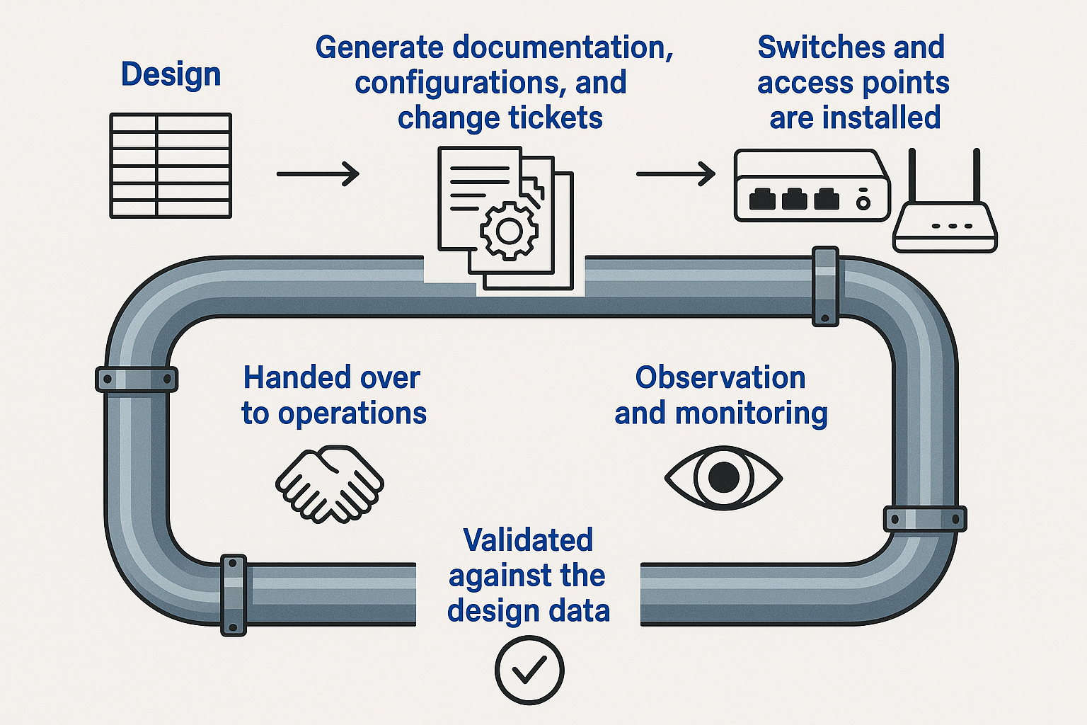
Example

Slide 20
Conclusions

Slide 21
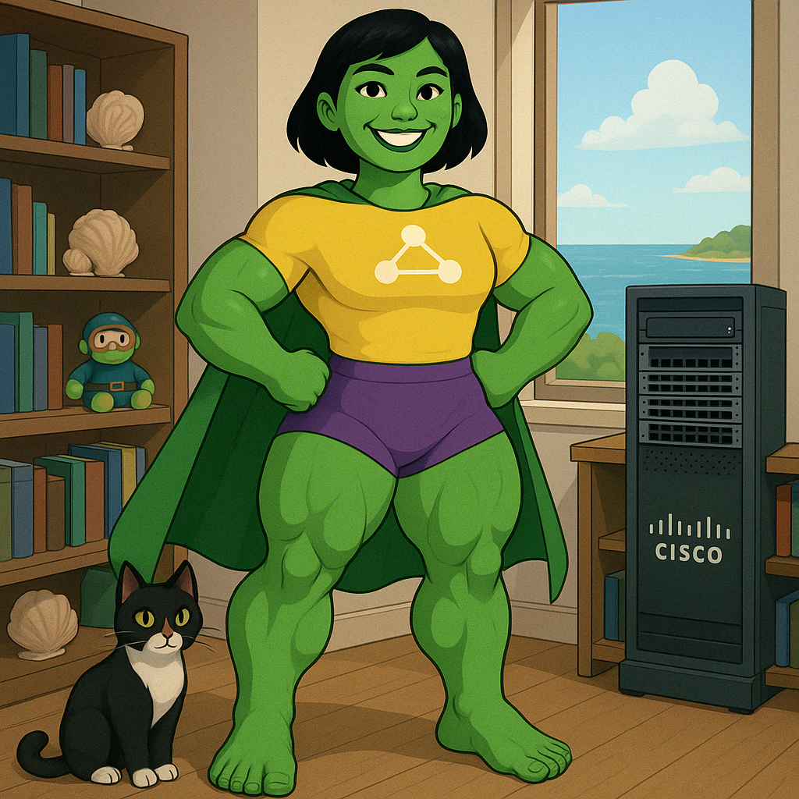
Legs AND upper body
Enablers of high-quality, end-to-end service delivery

Slide 22
New Beginning (Our 4 key questions)
Requirements
Leadership
Resources
Support
Beginnings are hard but you just need the first step

Slide 23
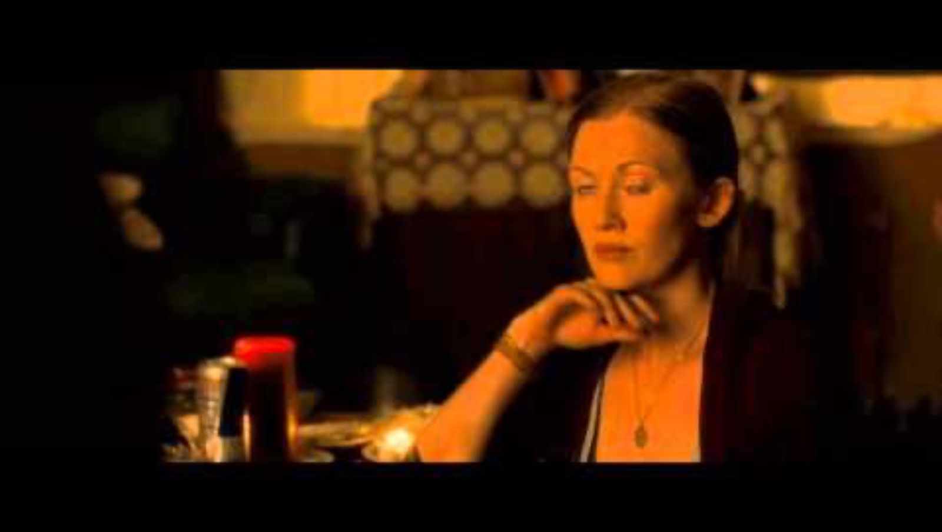
Movimiento es vida
Notes:
https://www.youtube.com/watch?v=lAnruEKBBF4

Slide 24
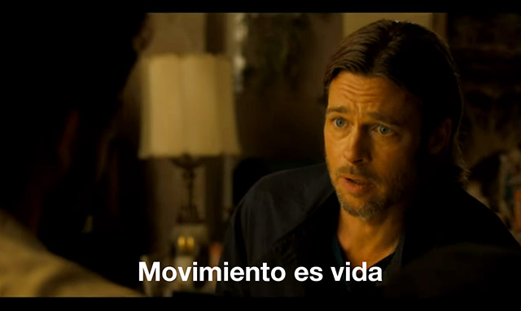

Slide 25
Distractions
Why should I care?
Is this getting me closer to the finish line?

Slide 26
AutoCon
Now let’s turn to a different beginning
I am a result of NAF
What I know now after AC0 - AC2
Tough decisions on our horizon for some of us
This community is uniquely positioned to help
as long as we don't forget about those just starting
Notes:
What I have learned by being part of this community
1. Network automation is software development
2. we have to differentiate personal productivity and growth from service delivery
3. we have a long road ahead educating leadership
4. we have all the tools we need
5.

Slide 27
Its time to differentiate
Personal productivity and skills
Service delivery
Network Engineer
Software Developer

Slide 28
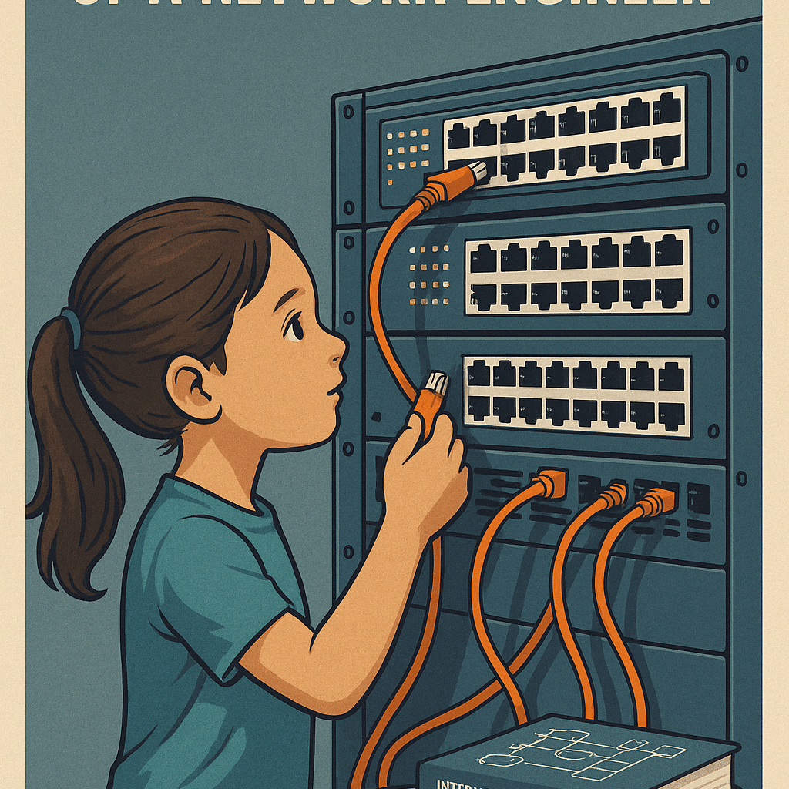
The evolution of a network engineer

Slide 29
Hodně štěstí a pevné zdraví! Děkuju
Notes:
Hodně štěstí = Good luck Pevné zdraví = Strong (good) health
Thank you

Slide 30
Questions?

